Slide 1
VUE.js
Garret Mullings
Rory Schillo

Slide 2

What is VUE.js?
Javascript Framework for frontend development
Features:
Declarative Rendering: imbed HTML in javascript
Reactivity: update DOM when javascript state changes
Mimics OOP programming!

Slide 3
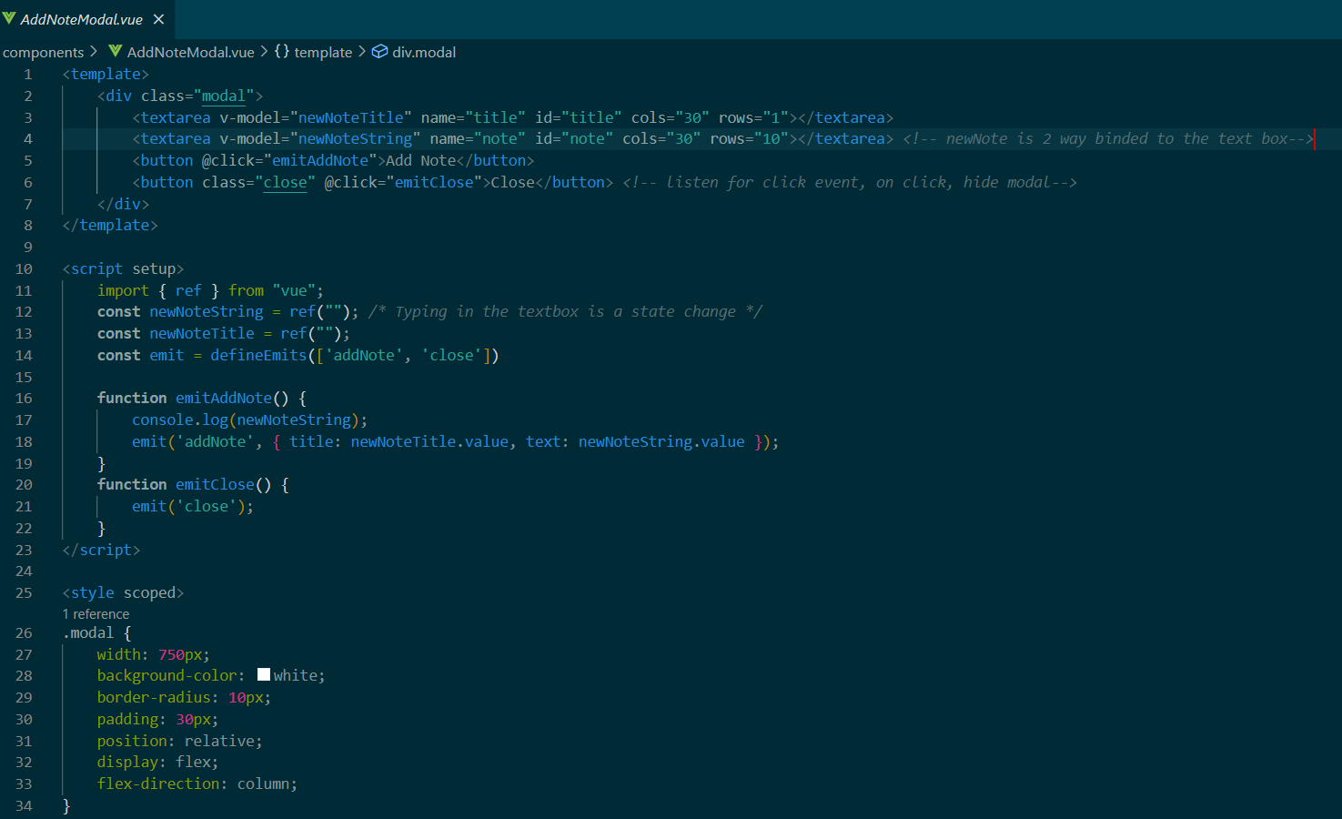
Components
Put your HTML, Javascript, and CSS styling all in a single, encapsulated file

Slide 4
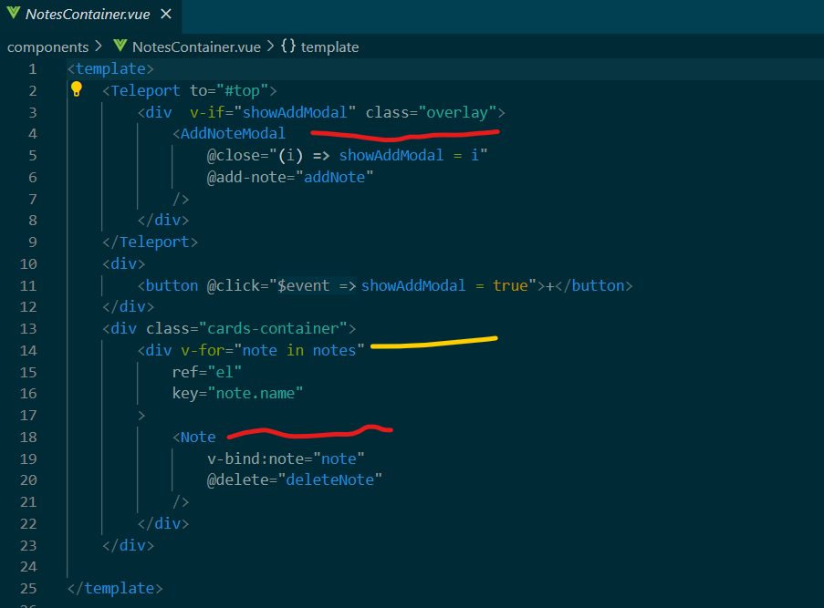
Components
Once created, components can be used and reused anywhere. Much like a Java class!
Red lines are components created in separate files.
Yellow line is a for-loop

Slide 5
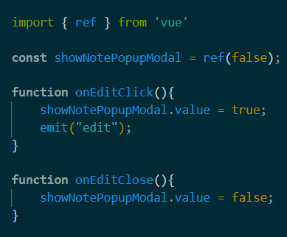
Reactivity:
Due use reactivity, wrap your variables with vue’s ref() function.
Then, when the variable’s .value field is updated the DOM is updated automatically

Slide 6
Conclusion
Declarative Rendering
Reactivity
Components allow HTML, Javascript, and CSS to be encapsulated in a single file.
Components can be reused anywhere
When variables change in the Javascript the DOM is updated automatically
Variables must be wrapped with ref()

Slide 7
PROJECT Demo
VUE NOTES

